Slide 1


Soft Morphological Processing of Tactile Stimuli
for Autonomous Category Formation
Luca Scimeca, Perla Maiolino, Fumiya Iida
ls769@cam.ac.uk, pm640@cam.ac.uk, fi224@cam.ac.uk

Slide 2
Outline
Goal & Motivation
Experimental Outline & Morphological Processing
Unsupervised Category Formation
Results
Q&A

Slide 3
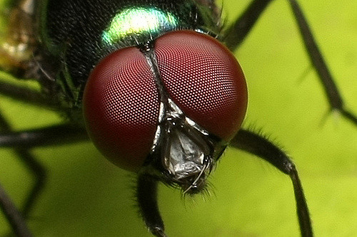
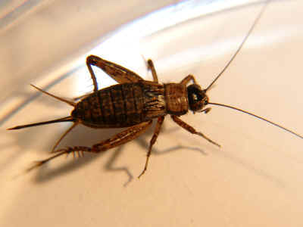

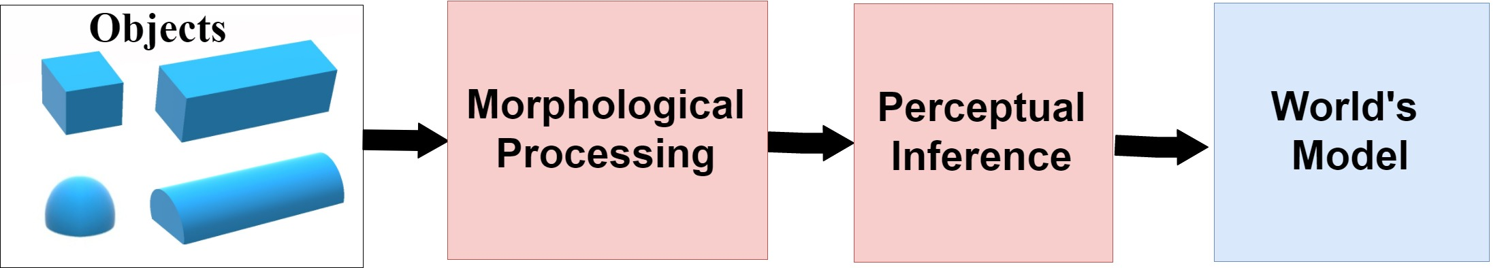
Goal & Motivation

Slide 4
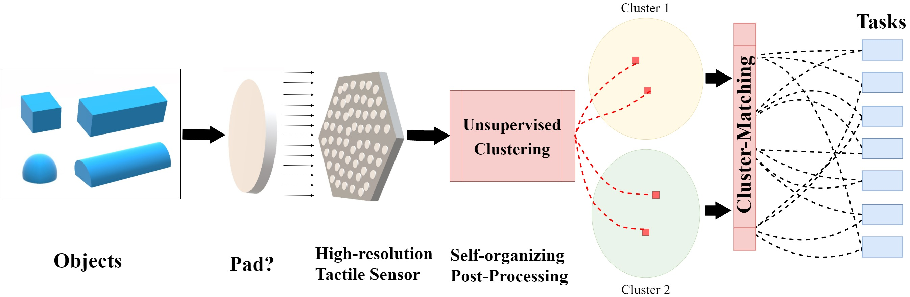
Experimental Outline –Theoretical Framework

Slide 5
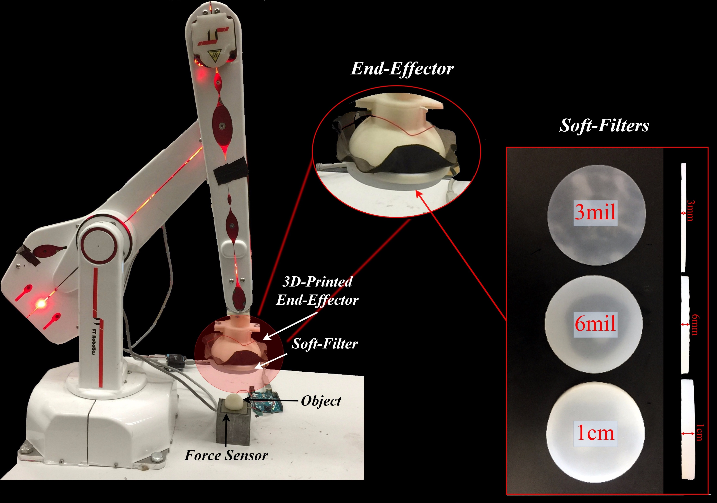
Experimental Outline –Experimental Set-Up

Slide 6
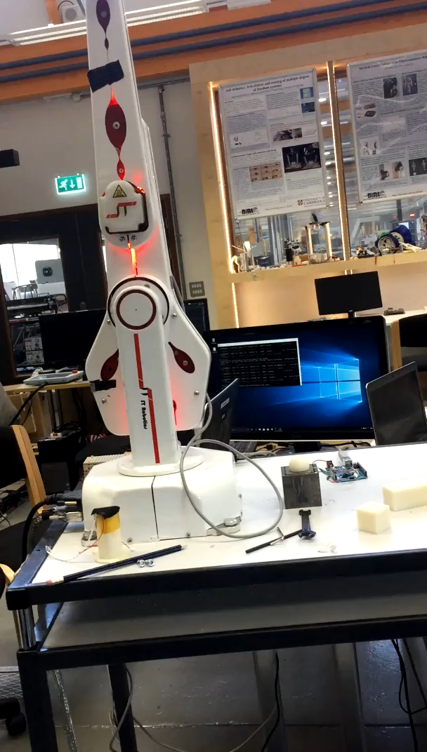
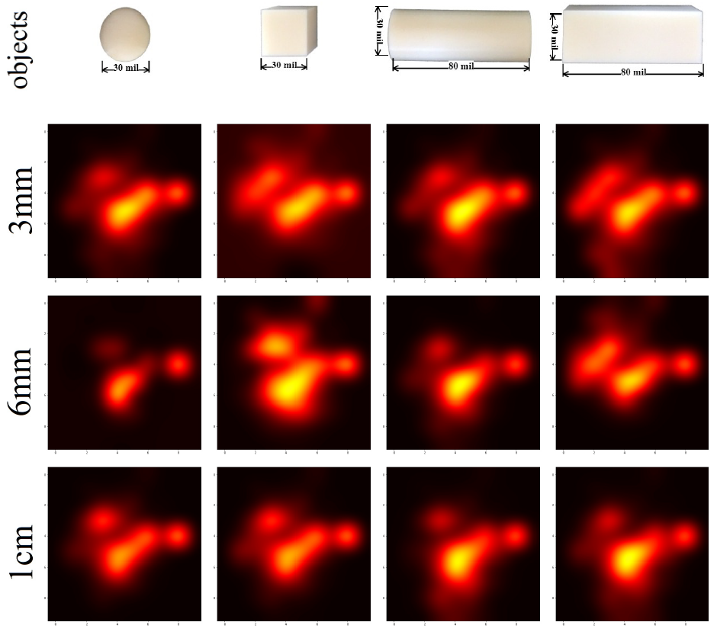
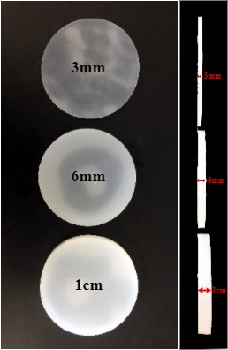
Experimental Outline –Morphological Preprocessing

Slide 7
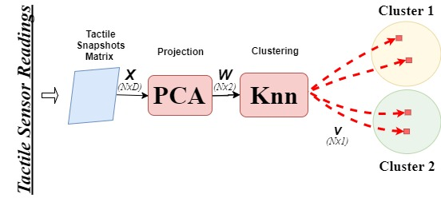
Unsupervised Category Formation

Slide 8
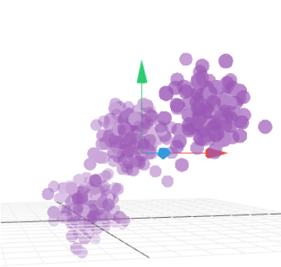
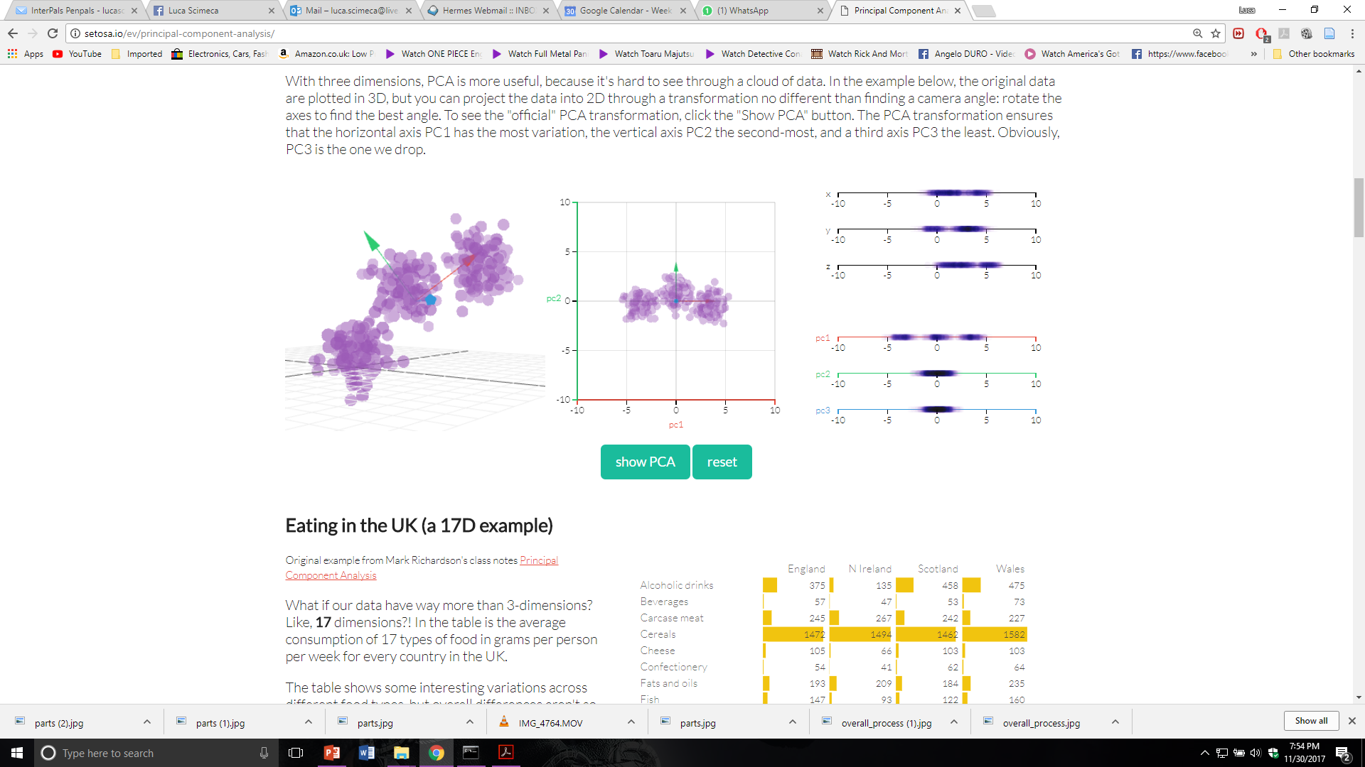
Unsupervised Category Formation - PCA
Original Data
Principal Axis Retrival
Projection

Slide 9
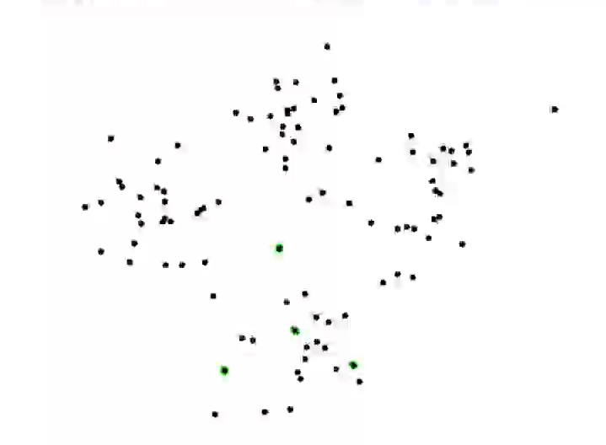
Unsupervised Category Formation - KMC

Slide 10
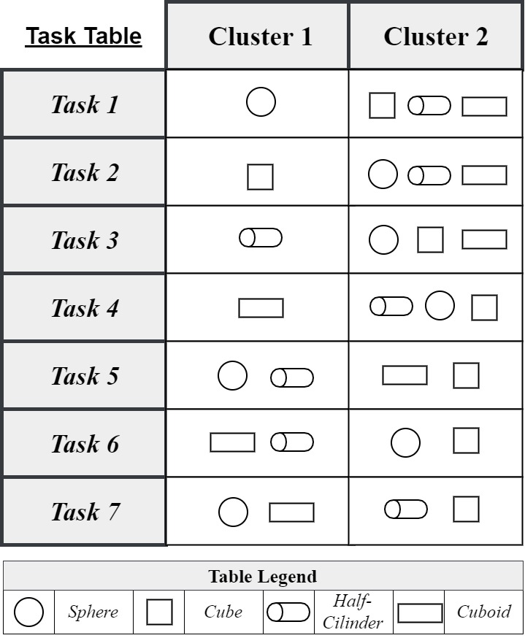
Tasks

Slide 11
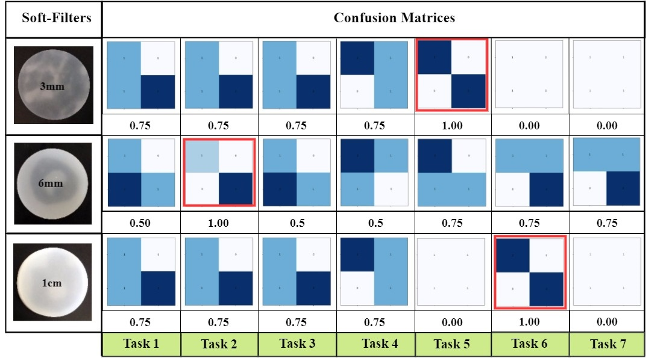
Results – Confusion Matrices

Slide 12
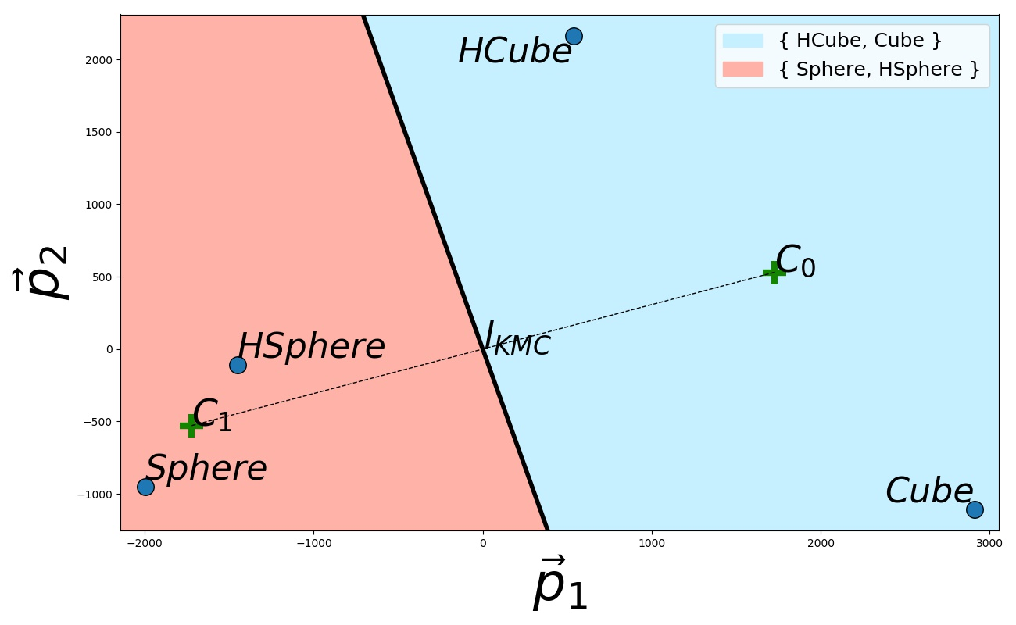
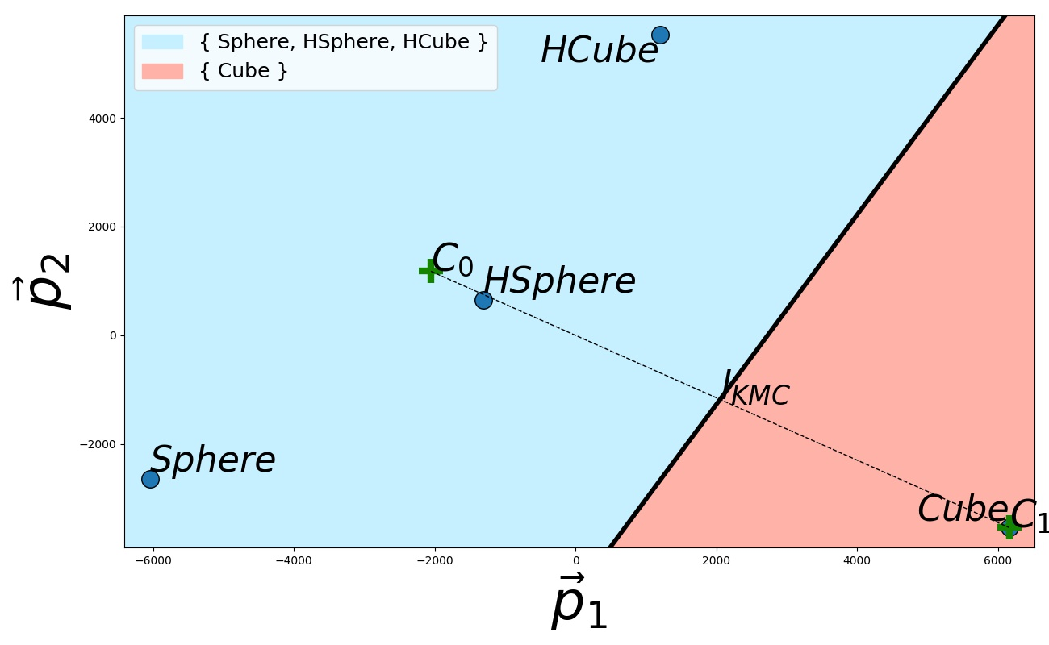
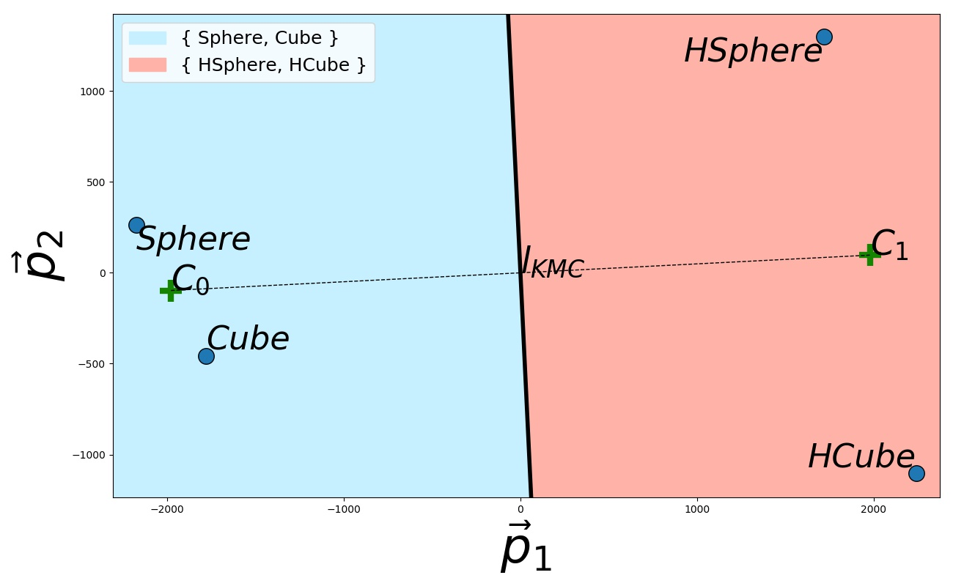
Results
3mm soft-filter
6mm soft-filter
1cm soft-filter

Slide 13
Recall…

Slide 14
Thank you
Luca Scimeca
ls769@cam.ac.uk

